Slide 1
Evaluating Functions From Tables
College Algebra

Slide 2
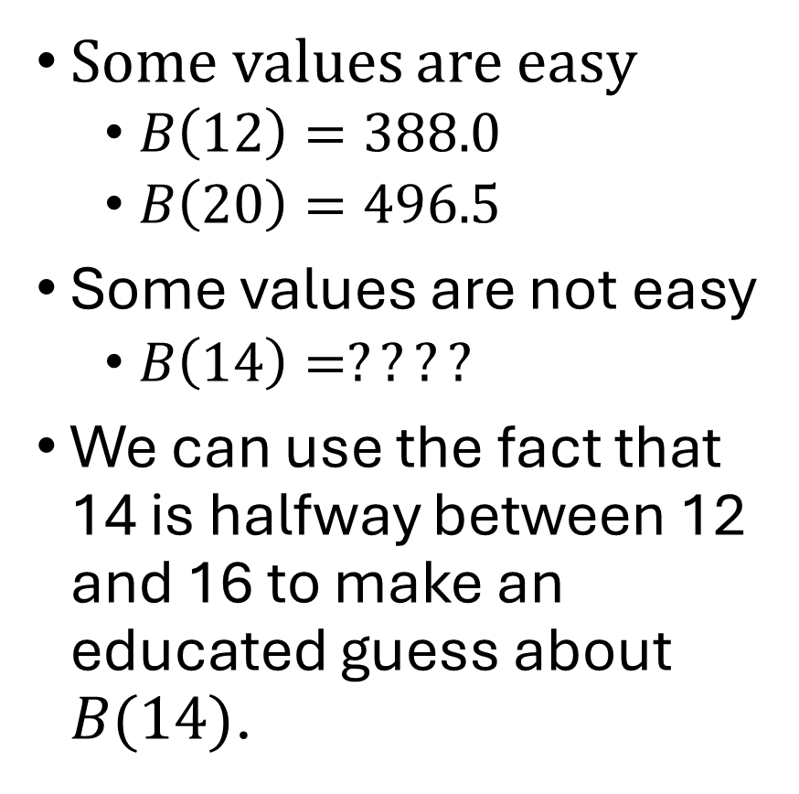
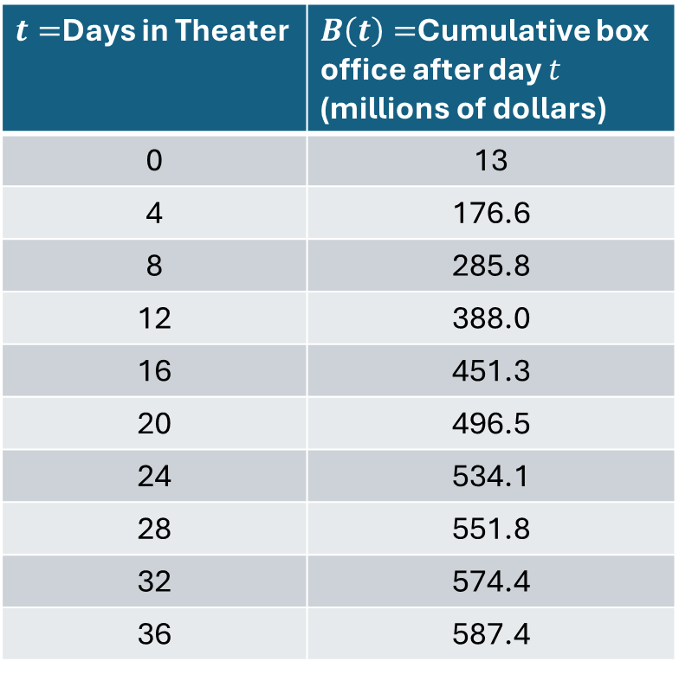
Example 1
$t=$Days in Theater | $B\left(t\right)=$Cumulative box office after day $t$ (millions of dollars)
0 | 13
4 | 176.6
8 | 285.8
12 | 388.0
16 | 451.3
20 | 496.5
24 | 534.1
28 | 551.8
32 | 574.4
36 | 587.4
Some values are easy
$B\left(12\right)=388.0$
$B\left(20\right)=496.5$
Some values are not easy
$B\left(14\right)=????$
We can use the fact that 14 is halfway between 12 and 16 to make an educated guess about $B(14)$.

Slide 3
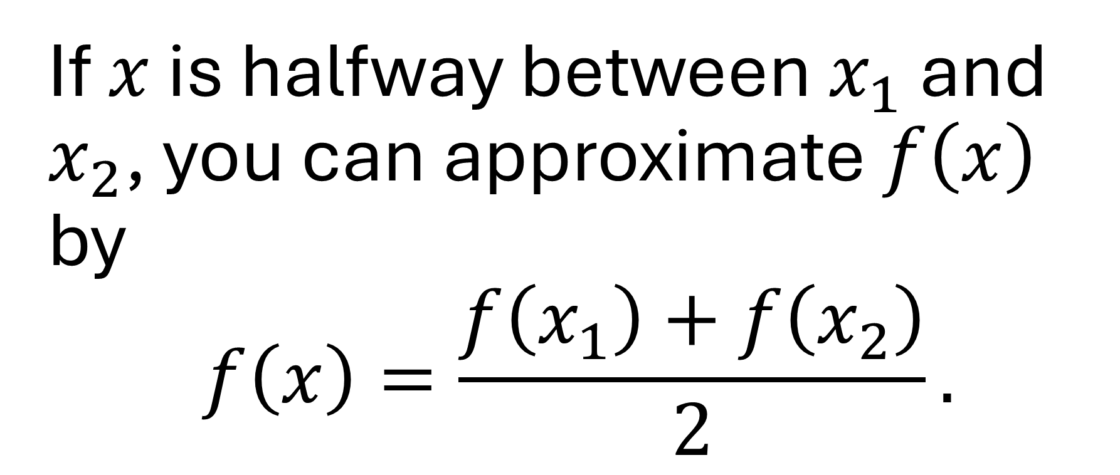
Approximation Rule
If $x$ is halfway between $x_{1}$ and $x_{2}$, you can approximate $f\left(x\right)$ by $$f\left(x\right)=\frac{f\left(x_{1}\right)+f\left(x_{2}\right)}{2}.$$

Slide 4
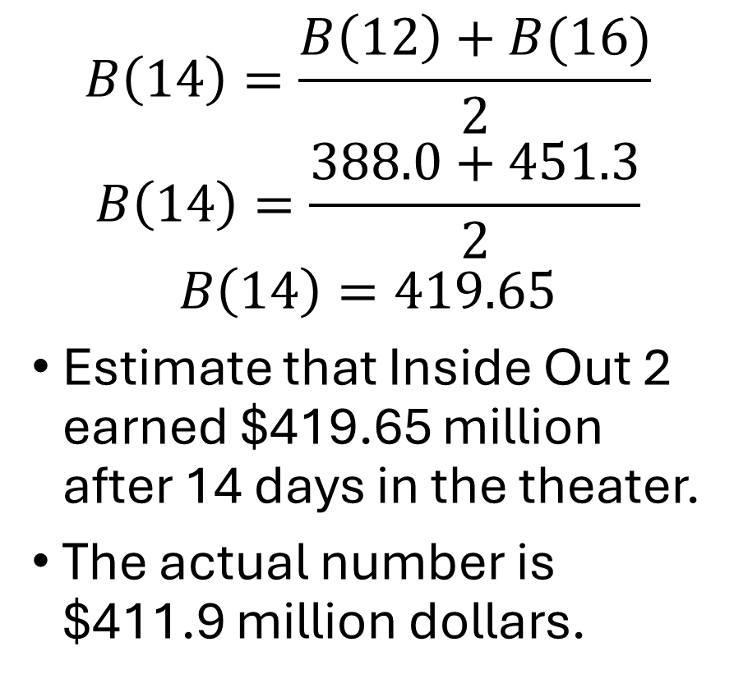
Example 2
$t=$Days in Theater | $B\left(t\right)=$Cumulative box office after day $t$ (millions of dollars)
0 | 13
4 | 176.6
8 | 285.8
12 | 388.0
16 | 451.3
20 | 496.5
24 | 534.1
28 | 551.8
32 | 574.4
36 | 587.4
$$B\left(14\right)=\frac{B\left(12\right)+B(16)}{2}$$
$$B\left(14\right)=\frac{388.0+451.3}{2}$$
$$B\left(14\right)=419.65$$
Estimate that Inside Out 2 earned $419.65 million after 14 days in the theater.
The actual number is $411.9 million dollars.

